Slide 1
Bank Loan Case Study
Manan Yadav
yadavmry5051@gmail.com

Slide 2
Table of Contents
01
02
03
04
Project Description
Brief description of what the project is about
Approach
What was the approach to solve this project
Insights
Through solving this project what insights we got
Results
Finally what did we learn and what was the final outcome of the project

Slide 3
Project Description
In this project, we have performed Exploratory Data Analysis (EDA) on Bank Loan Dataset.
The aim of this project is to give you an idea of applying EDA techniques in a real business scenario. It develops a basic understanding of the RISK ANALYSIS in the banking and financial sectors.
The loan-providing companies find it hard to give loans to people due to their insufficient or non-existent credit history. Because of that, some consumers use it to their advantage by becoming defaulters.
The main aim is to identify patterns that indicate if a client has difficulty paying their installments which may be used for taking actions such as denying the loan, reducing the amount of the loan, lending (to risky applicants) at a higher interest rate, etc. This will ensure that the consumers capable of repaying the loan are not rejected. Identification of such applicants using EDA is the aim of this case study.

Slide 4
Approach
Using MS Excel to study and understand datasets, especially the Columns dataset.
Using Jupyter Notebook for studying datasets and performing EDA on the dataset.
Then cleaning the datasets, handling missing values and errors, finding outliers, and data imbalance, performing variance analysis, and finding correlations using various statistical functions.
Withdrawing insights through presenting various plots and graphs.

Slide 5
Tech-Stack Used
Microsoft Excel
Microsoft PowePoint
Jupyter Notebook

Slide 6
Understanding the Datasets
application_data.csv
column_description.csv
previous_application.csv
It contains all the information of the client at the time of application. The data is about whether a client has payment difficulties.
It is data dictionary which describes the meaning of the variables.
It contains information about the client’s previous loan data. It contains the data on whether the previous application had been Approved, Cancelled, Refused, or Unused offer

Slide 7
Analysis of application_data.csv

Slide 8
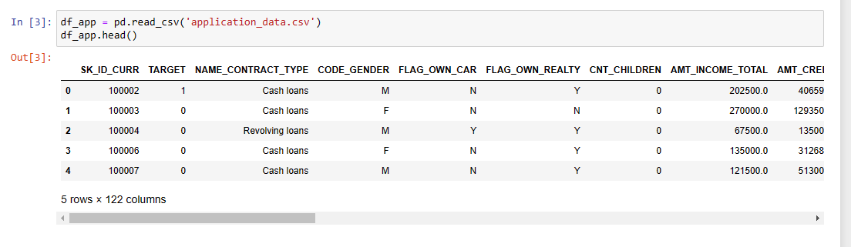
Loading dataset
The dataset was loaded and all the columns were read for further data inspections (122 columns were detected).

Slide 9
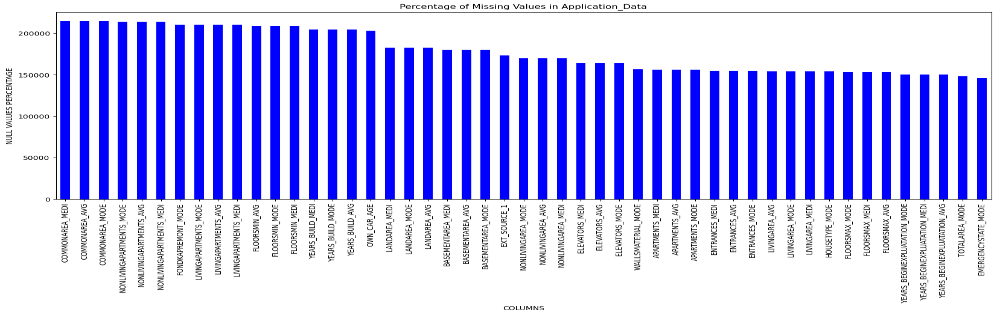
Data inspection & cleaning
Reading the total no. of rows and columns- shape().
Checking datatypes- info().
Summarizing numeric columns- describe().
Calculating the Null Value Percentage(NVP).
The columns given in the picture below having NVP > 35% would be removed and others would be
imputed- mode() and median().

Slide 10
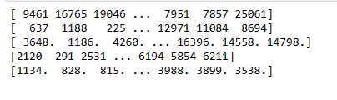
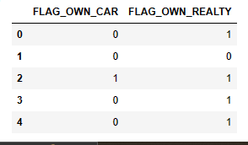
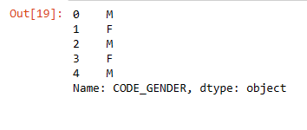
Error Handling
Converting Negative Days Column to Positive Days columns- abs() and unique().
Replacing Flag Columns from ‘Y’ and ‘N’ to 1 and 0.
Replacing XNA values to ‘F’ in Gender Column.

Slide 11
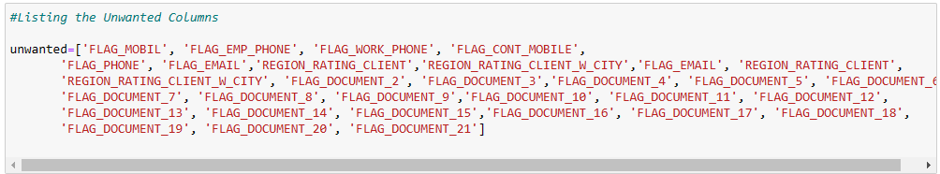
Binning data
The following list of columns were binned into groups for better readability and analysis:-
AMT_INCOME_TOTAL to Income Group
AMT_CREDIT to Credit Group
DAYS_BIRTH to Age Group
Unwanted Columns were removed.

Slide 12
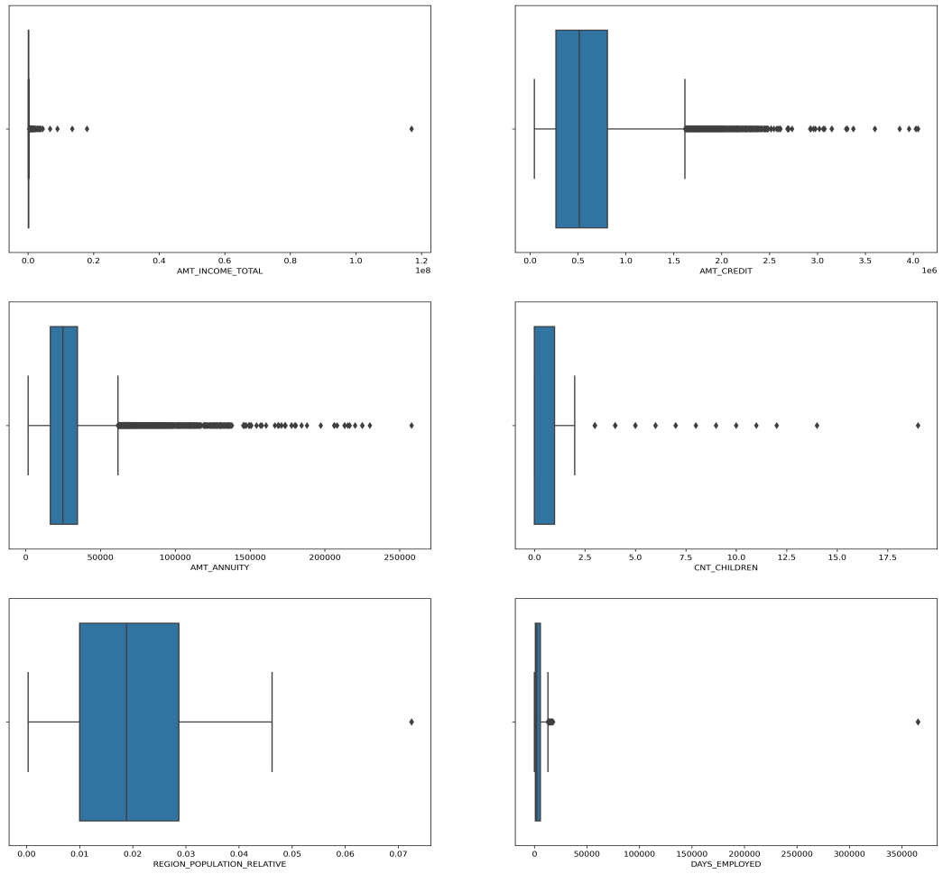
Outliers analysis
IQR for AMT_INCOME_TOTAL is very slim
and it has a large number of outliers.
Third quartile of AMT_CREDIT is larger as compared to the First quartile which means that most of the Credit amount of the loan of customers is present in the third quartile. And there is a large number of outliers present in AMT_CREDIT.
Third quartile of AMT_ANNUITY is slightly larger than the First quartile and there are a large number of outliers.
CNT_CHILDREN have outlier values having
children more than 5.
IQR for DAYS EMPLOYED is very slim. Most of the outliers are present below 25000. And the outlier is present 375000.

Slide 13
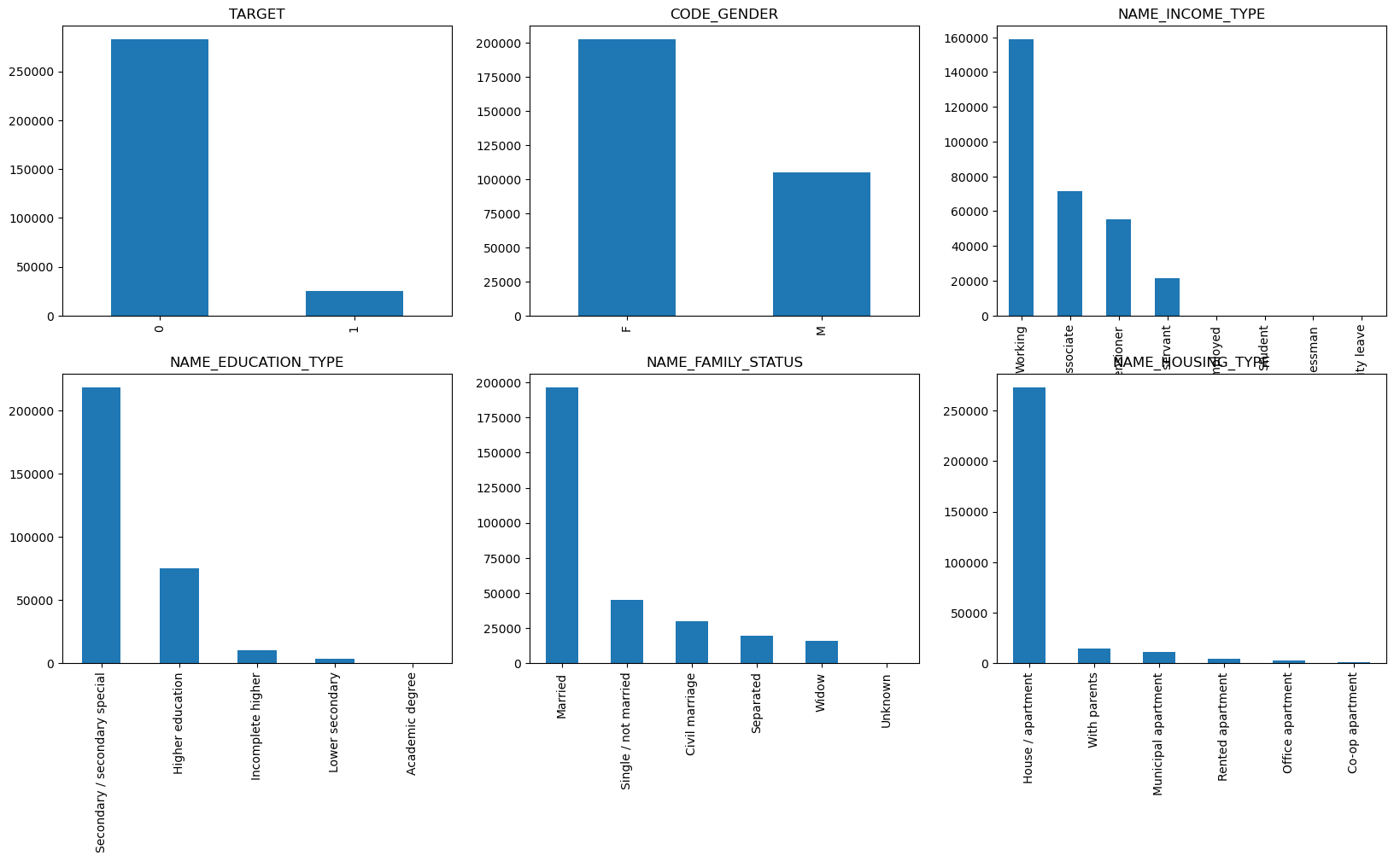
Data imbalance
Data imbalance was calculated for various
columns.
From the graphs we found that the TARGET column has the highest imbalance.
On calculating we found the Data
Imbalance Ratio is 11.39 : 1
TARGET 0 – Re-payers (Non- Defaulters).
TARGET 1 – Defaulters.

Slide 14
Univariate Analysis
Univariate analysis explores each variable in a data set, separately. It looks at the range of values, as well as the central tendency of the values. It describes the pattern of response to the variable. It describes each variable on its own. Descriptive statistics describe and summarize data.
Analysis was performed based on Categorical and Continuous Data
Count Plots were generated for Categorical Data.
Distribution Plots were generated for Continuous Data.

Slide 15
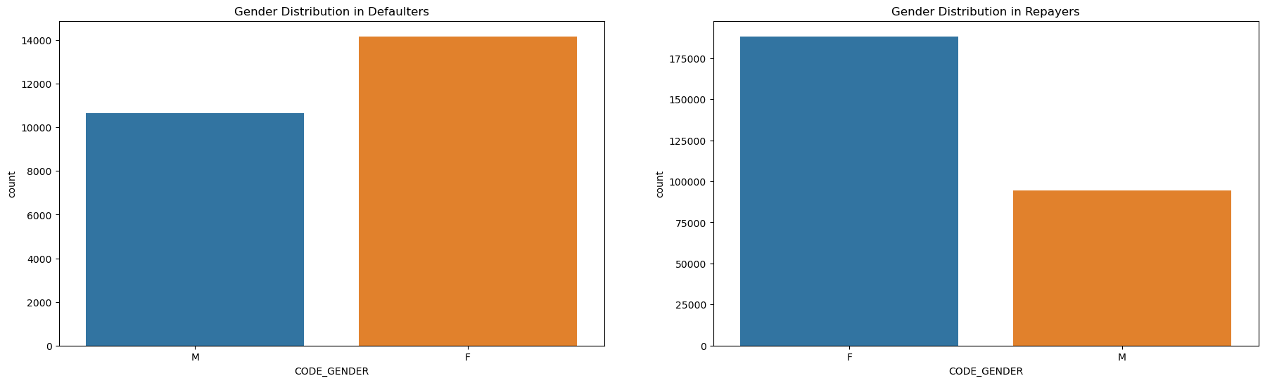
Insights
Based on Gender
Defaulters - We can see that females are slightly more in number of defaulters than male.
Non-defaulters - The same pattern continues for non-defaulters as well. The females are more in
number here than male.

Slide 16
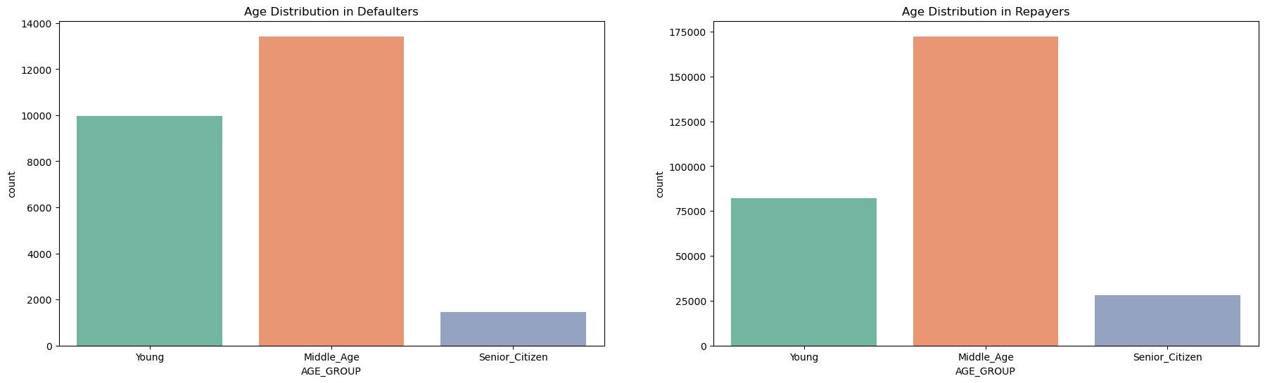
Based on Age
Defaulters - We can see that Middle_Age group are most in number of defaulters while Senior_citizens are least.
Re-payers - The same pattern continues for non-defaulters as well.

Slide 17
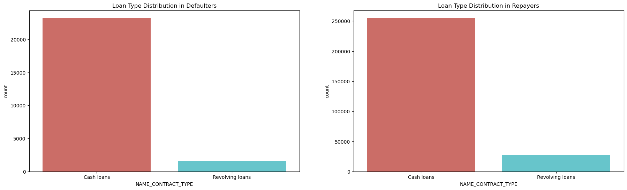
Based on Loan Type
We see in both the cases that Revolving loans are very less in number compared to Cash loans.

Slide 18
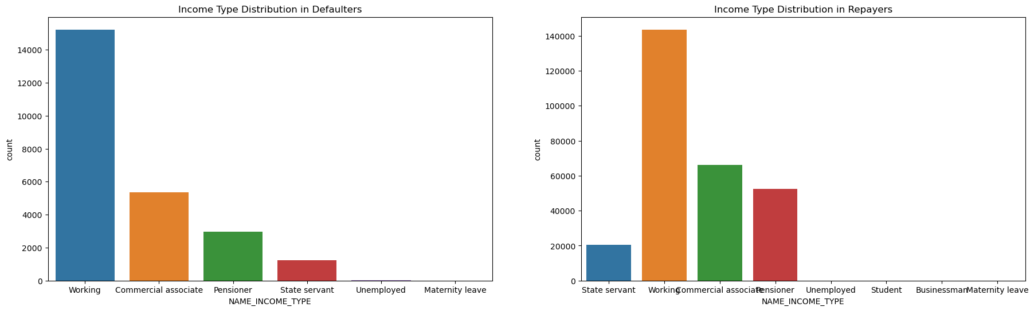
Based on Income Type
Defaulters - Working people are mostly defaulted as their numbers are high with compare to other pfrofessions.
Repayers - Similarly here also working people are more in number who are not defaulted.

Slide 19
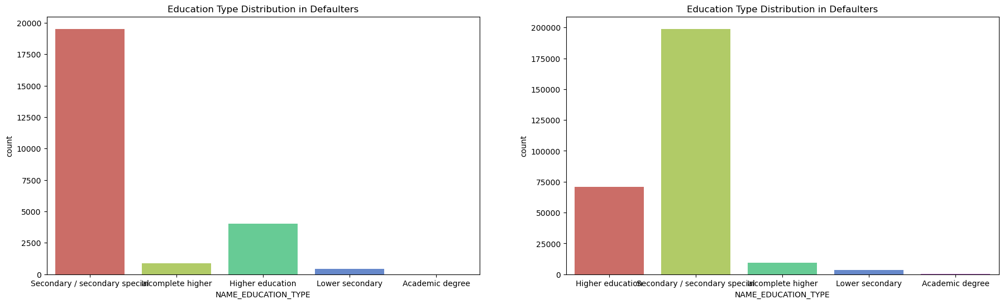
Based on Education Type
Defaulters - Education with Secondary/Secondary special customers are more number in defaulters compare with other level of educated people.
Re-payers - Same pattern follows.

Slide 20
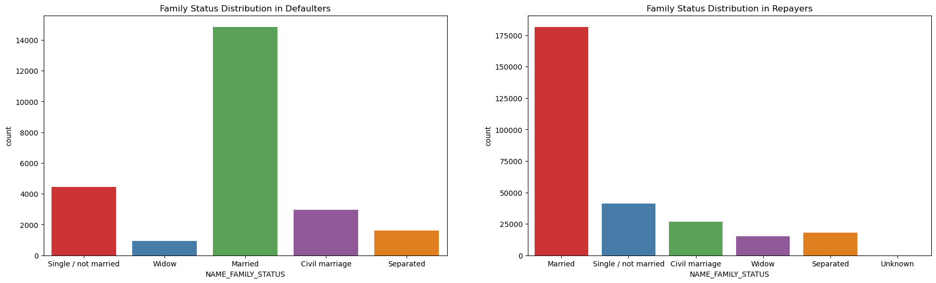
Based on Family Status
Defaulters- Married people are mostly defaulters.
Re-payers- Same pattern follows.

Slide 21
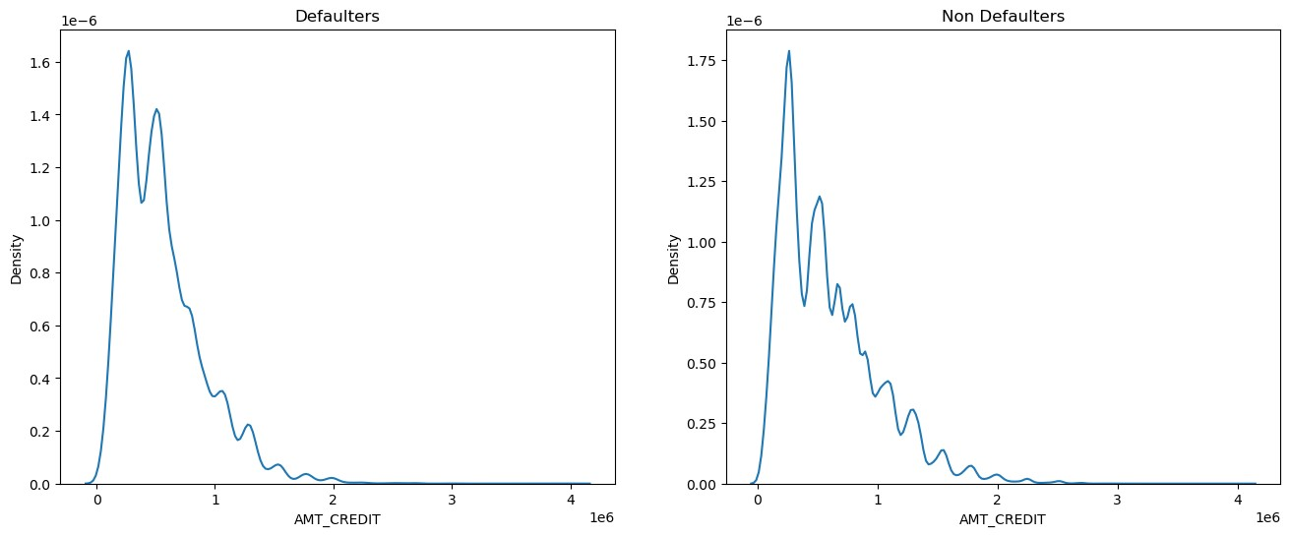
Insights (Continuous Data)
Based on Credit Amount
Defaulters - We can notice that the lesser the credit amount of the loan, the more chances of being defaulter. The spike is till 500000.
Non defaulters - If the credit amount is less, there is lesser chance of being defaulted. And gradually the chance is being decreased with the loan credit amount.

Slide 22
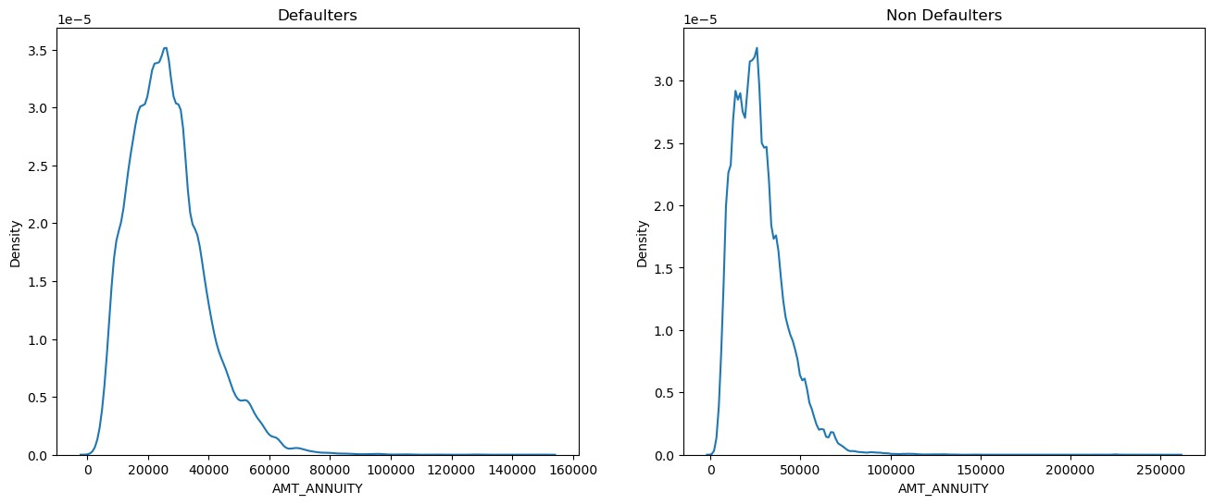
Based on Amount Annuity
In both the cases the loan annuity is concentrated more from 10000 to 40000.

Slide 23
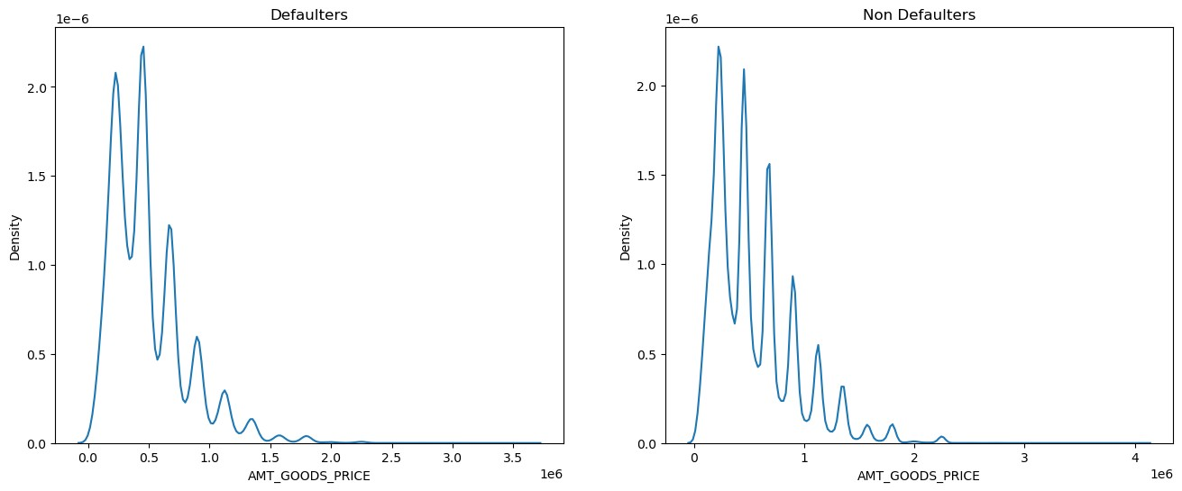
Based on Goods Price Amount
Both Defaulters and Non Defaulters shows same pattern.

Slide 24
Bivariate Analysis
Bivariate analysis is stated to be an analysis of any concurrent relation between two variables or attributes. This study explores the relationship of two variables as well as the depth of this relationship to figure out if there are any discrepancies between two variables and any causes of this difference.
Analysis was performed based on Numerical, Categorical and Continuous data.
Correlation matrix and plots were used for the analysis of Numerical Data.
Scatter Plots were used for analysis of Categorical Data.
Box plots were used for Continuous Data.

Slide 25
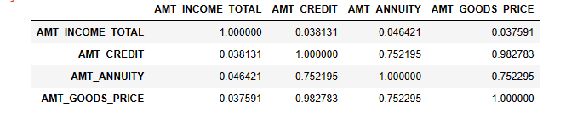
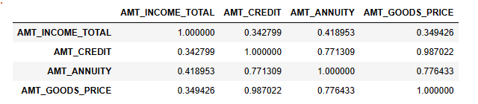
Insights (Numerical data)
Correlation matrix was first calculated For Defaulters and Re-payers separately and then graphs were plotted.

Slide 26
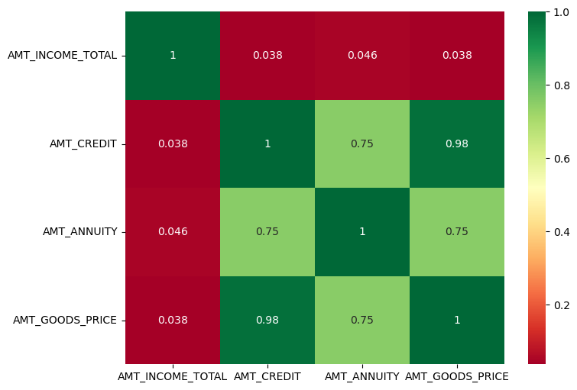
For Defaulters-
AMT_CREDIT and AMT_ANNUITY (0.74)
AMT_CREDIT and AMT_GOODS_PRICE (0.98)
AMT_ANNUITY and AMT_GOODS_PRICE (0.74)

Slide 27
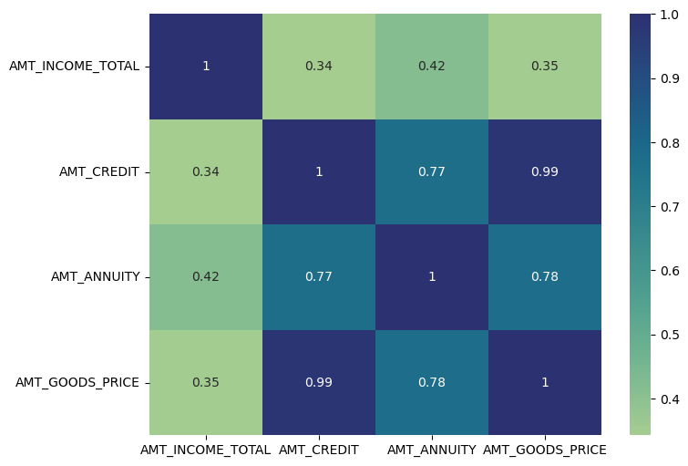
For Re-payers –
AMT_CREDIT and AMT_ANNUITY (0.76)
AMT_CREDIT and AMT_GOODS_PRICE (0.98)
AMT_ANNUITY and AMT_GOODS_PRICE (0.76)

Slide 28
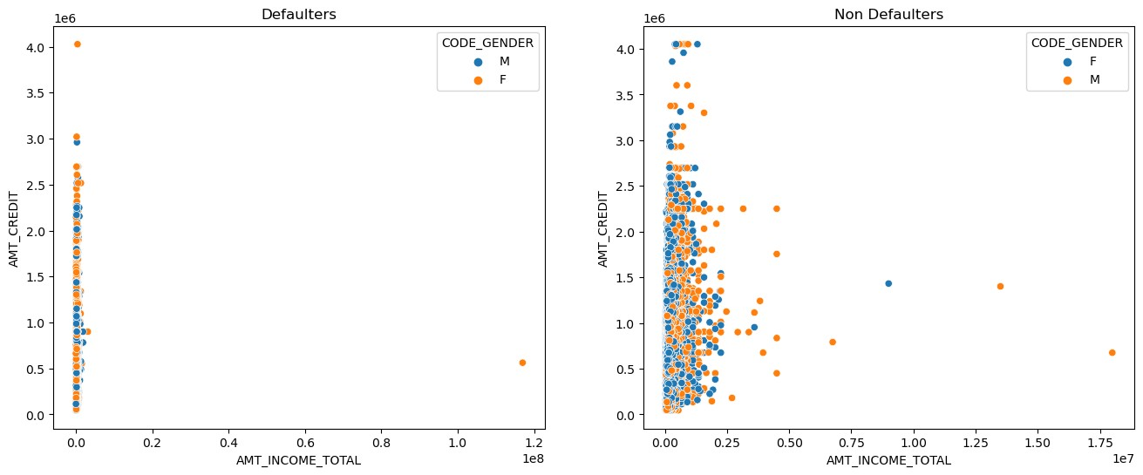
Insights (Continuous data)
Defaulters - We can slightly figure out that the values are more concentrated on the lower income and lower credit of the loan. That means as the income is increased, the amount of loan is also increased. This is true for both the genders.
Non defaulters - We can hardly figure out any pattern out of this.

Slide 29
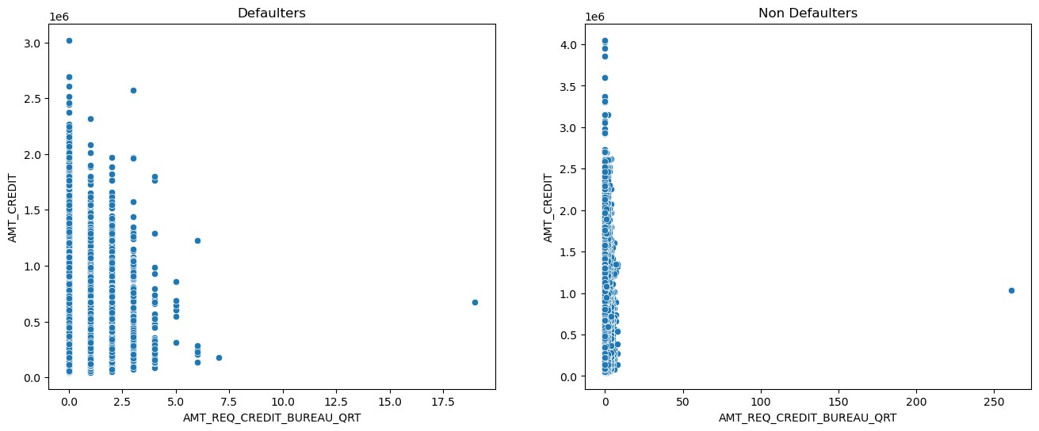
The more number of enquiries the lesser the amount of loan credited for both defaulters and non defaulters.

Slide 30
Insights (Continuous data)
Case of Defaulters-
Credit amount of the loans are very low for Revolving loans
There is no credit amount difference between genders, client owning cars or realty.
The Young age group got less amount of loan credited compared to mid age and senior citizen.
4.Higher income group have more loan amount credited.
5.Clients having higher external score have more loan amount.
Case of Non Defaulters-
Credit amount of the loans are very low for Revolving loans
There is no credit amount difference between genders, client owning cars or realty.
The mid age group got more amount of loan credited compared to young and senior citizen.
Higher income group have more loan amount credited and lower the lowest.
Clients having higher external score have more loan amount.
Surprisingly the unemployed people have spike in credit amount of loan
The Married people have more loan amount credited.

Slide 31
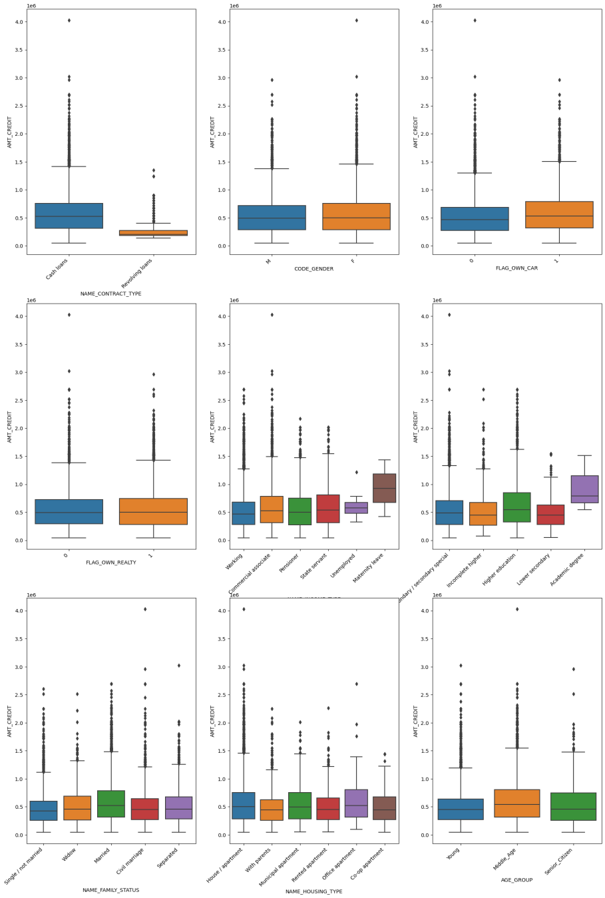
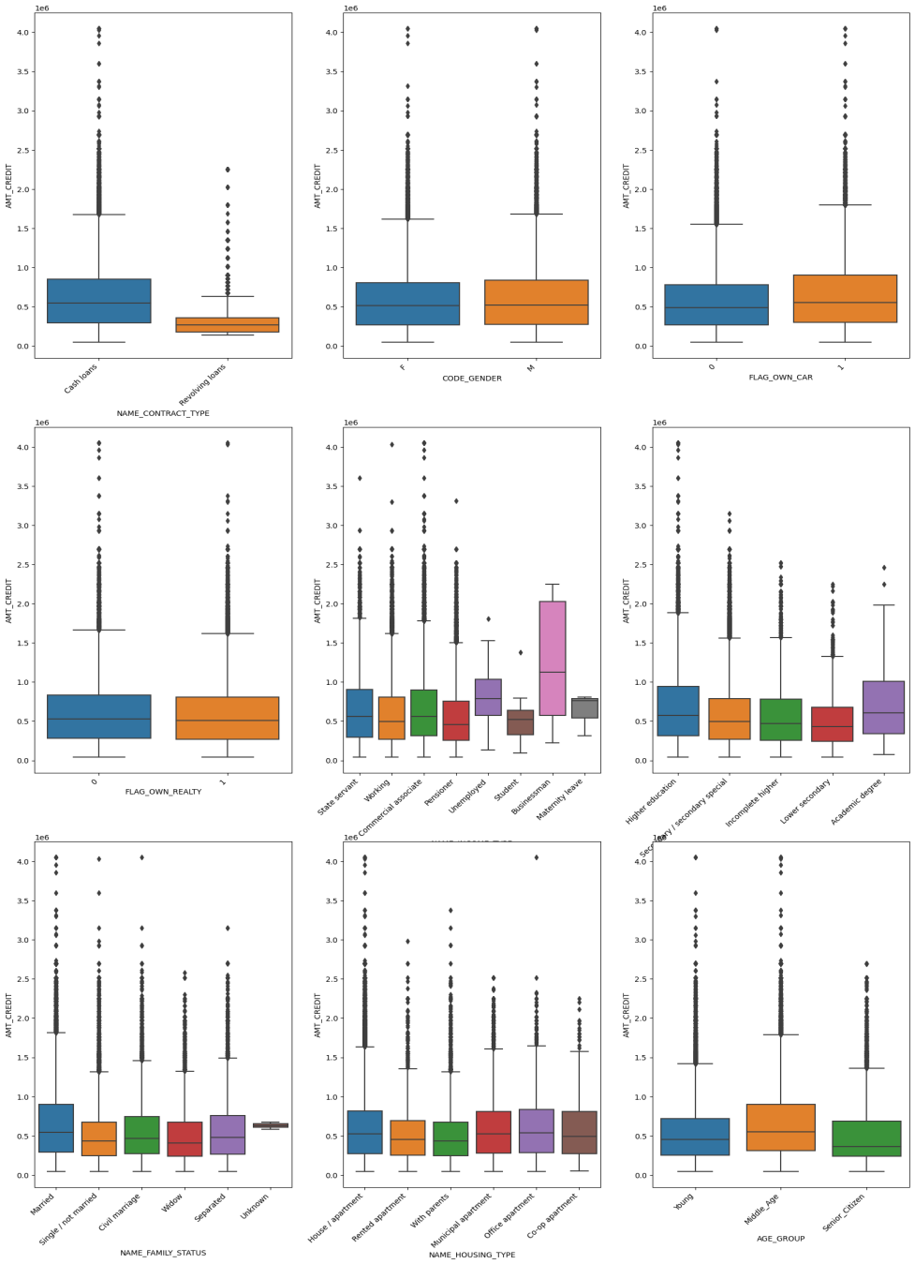

Slide 32
Correlation Analysis
Correlation Analysis is statistical method that is used to discover if there is a relationship between two variables/datasets, and how strong that relationship may be.
We have performed this analysis in two ways-
Using Pair plots
Using Heat maps

Slide 33
Insights on Pair Plots
AMT_CREDIT and AMT_GOODS_PRICE are highly correlated variables for both defaulters and non - defaulters. So as the home price increases the loan amount also increases.
AMT_CREDIT and AMT_ANNUITY (EMI) are highly correlated variables for both defaulters and non - defaulters . So as the home price increases the EMI amount also increases which is logical.
All three variables AMT_CREDIT, AMT_GOODS_PRICE and AMT_ANNUITY are highly correlated for both
defaulters and non-defaulters, which might not give a good indicator for defaulter detection.

Slide 34
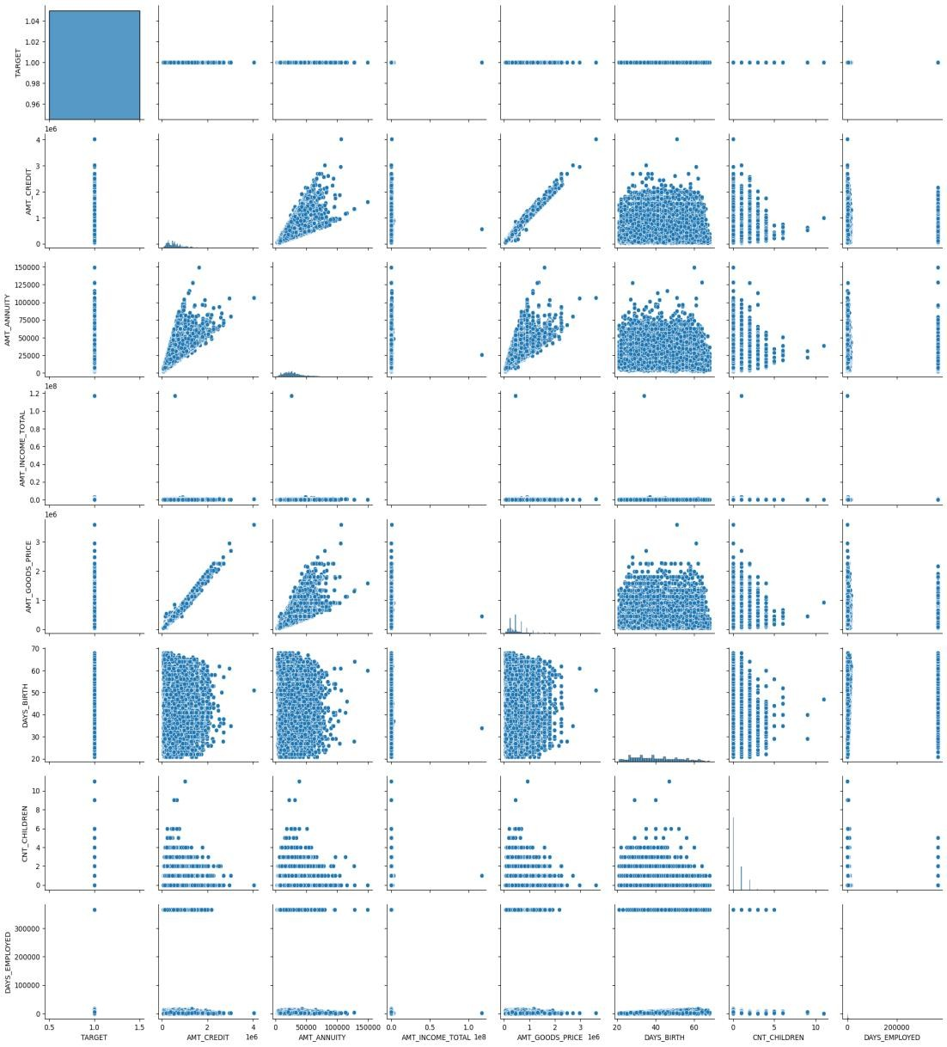
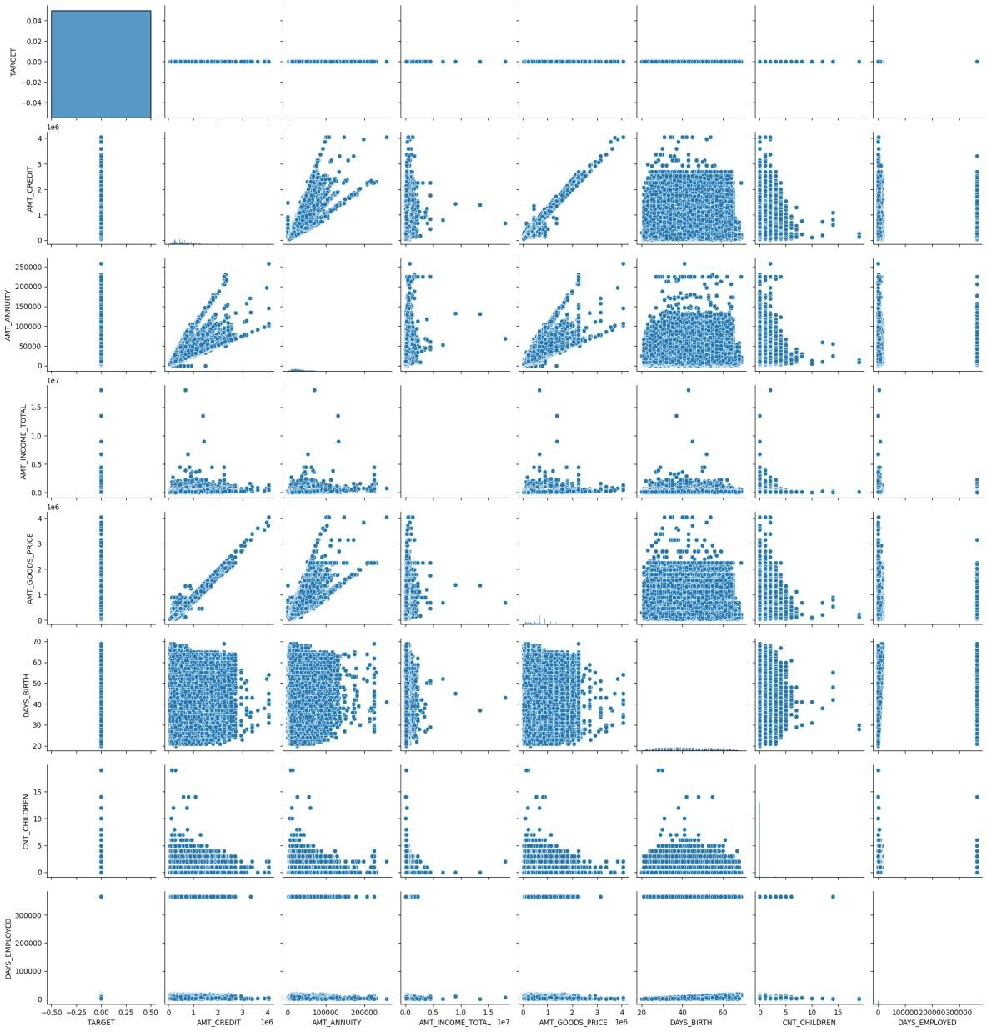

Slide 35
Insights ON Heat Map
Target 0
AMT_CREDIT is inversely proportional to the DAYS_BIRTH, peoples belong to the low-age group taking high Credit amounts and vice-versa
AMT_CREDIT is inversely proportional to the CNT_CHILDREN, which means the Credit amount is higher for fewer children count client has and vice-versa.
AMT_INCOME_TOTAL is inversely proportional to the CNT_CHILDREN, which means more income for fewer children the client have and vice-versa.
fewer children clients have in densely populated areas.
AMT_CREDIT is higher in densely populated areas.
AMT_INCOME_TOTAL is also higher in a densely populated area. Target 1
This heat map for Target 1 is also having quite a same observation just like Target 0. But for few points are different. They are listed below.
The client's permanent address does not match contact address are having less children.
The client's permanent address does not match work address are having less children.

Slide 36
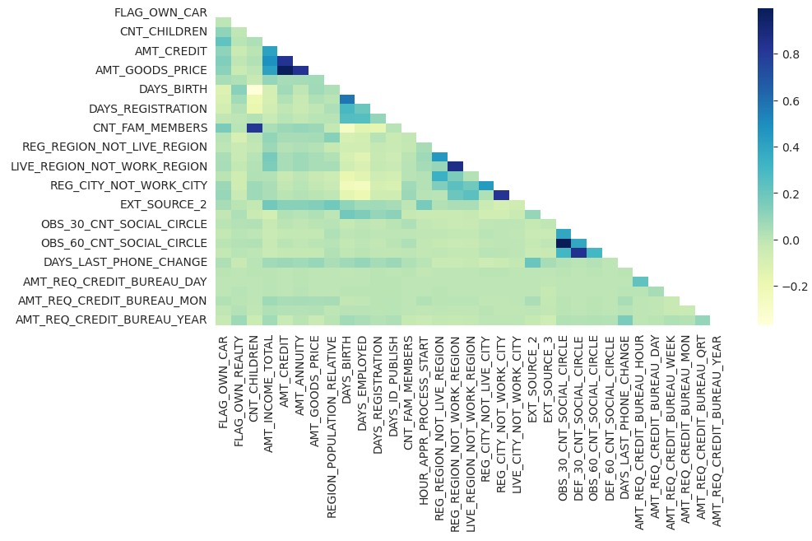
Target 0

Slide 37
Target 1

Slide 38
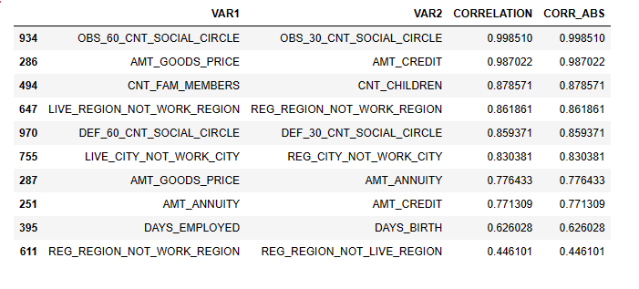
Top 10 Correlation
TARGET 0

Slide 39
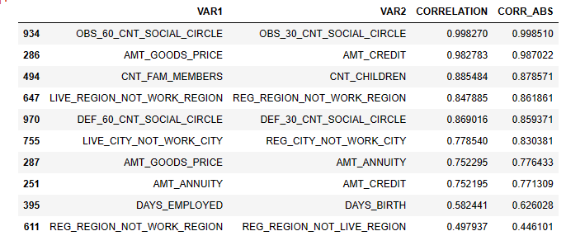
Top 10 Correlation
TARGET 1

Slide 40
Analysis of previous_application.csv

Slide 41
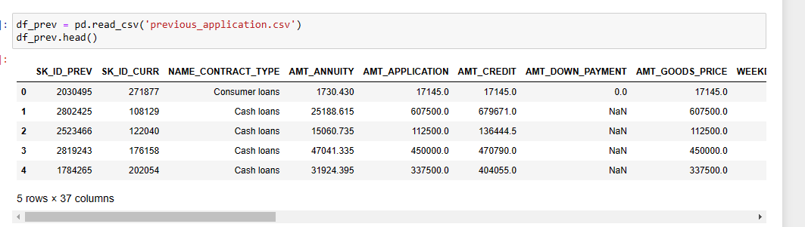
Loading Dataset
Dataset was loaded and all the columns were read for Data Inspection(37 columns were discovered)

Slide 42
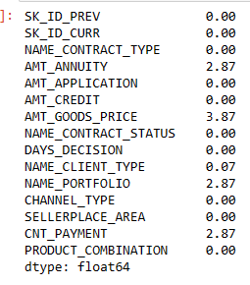
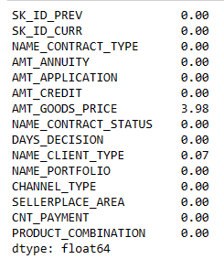
Handling Missing Values
Data inspection was performed similar to previous dataset and missing values were handled using Null Value percentage and imputations were performed.

Slide 43
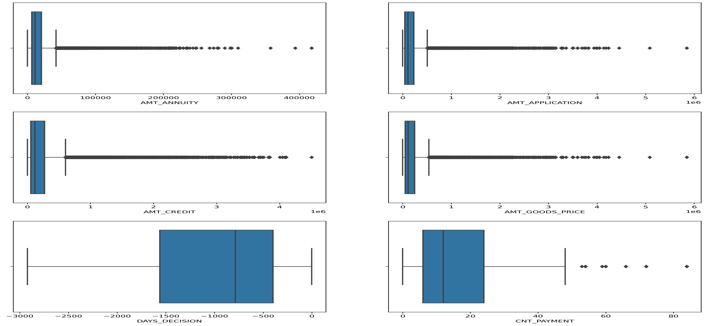
Outliers Analysis

Slide 44
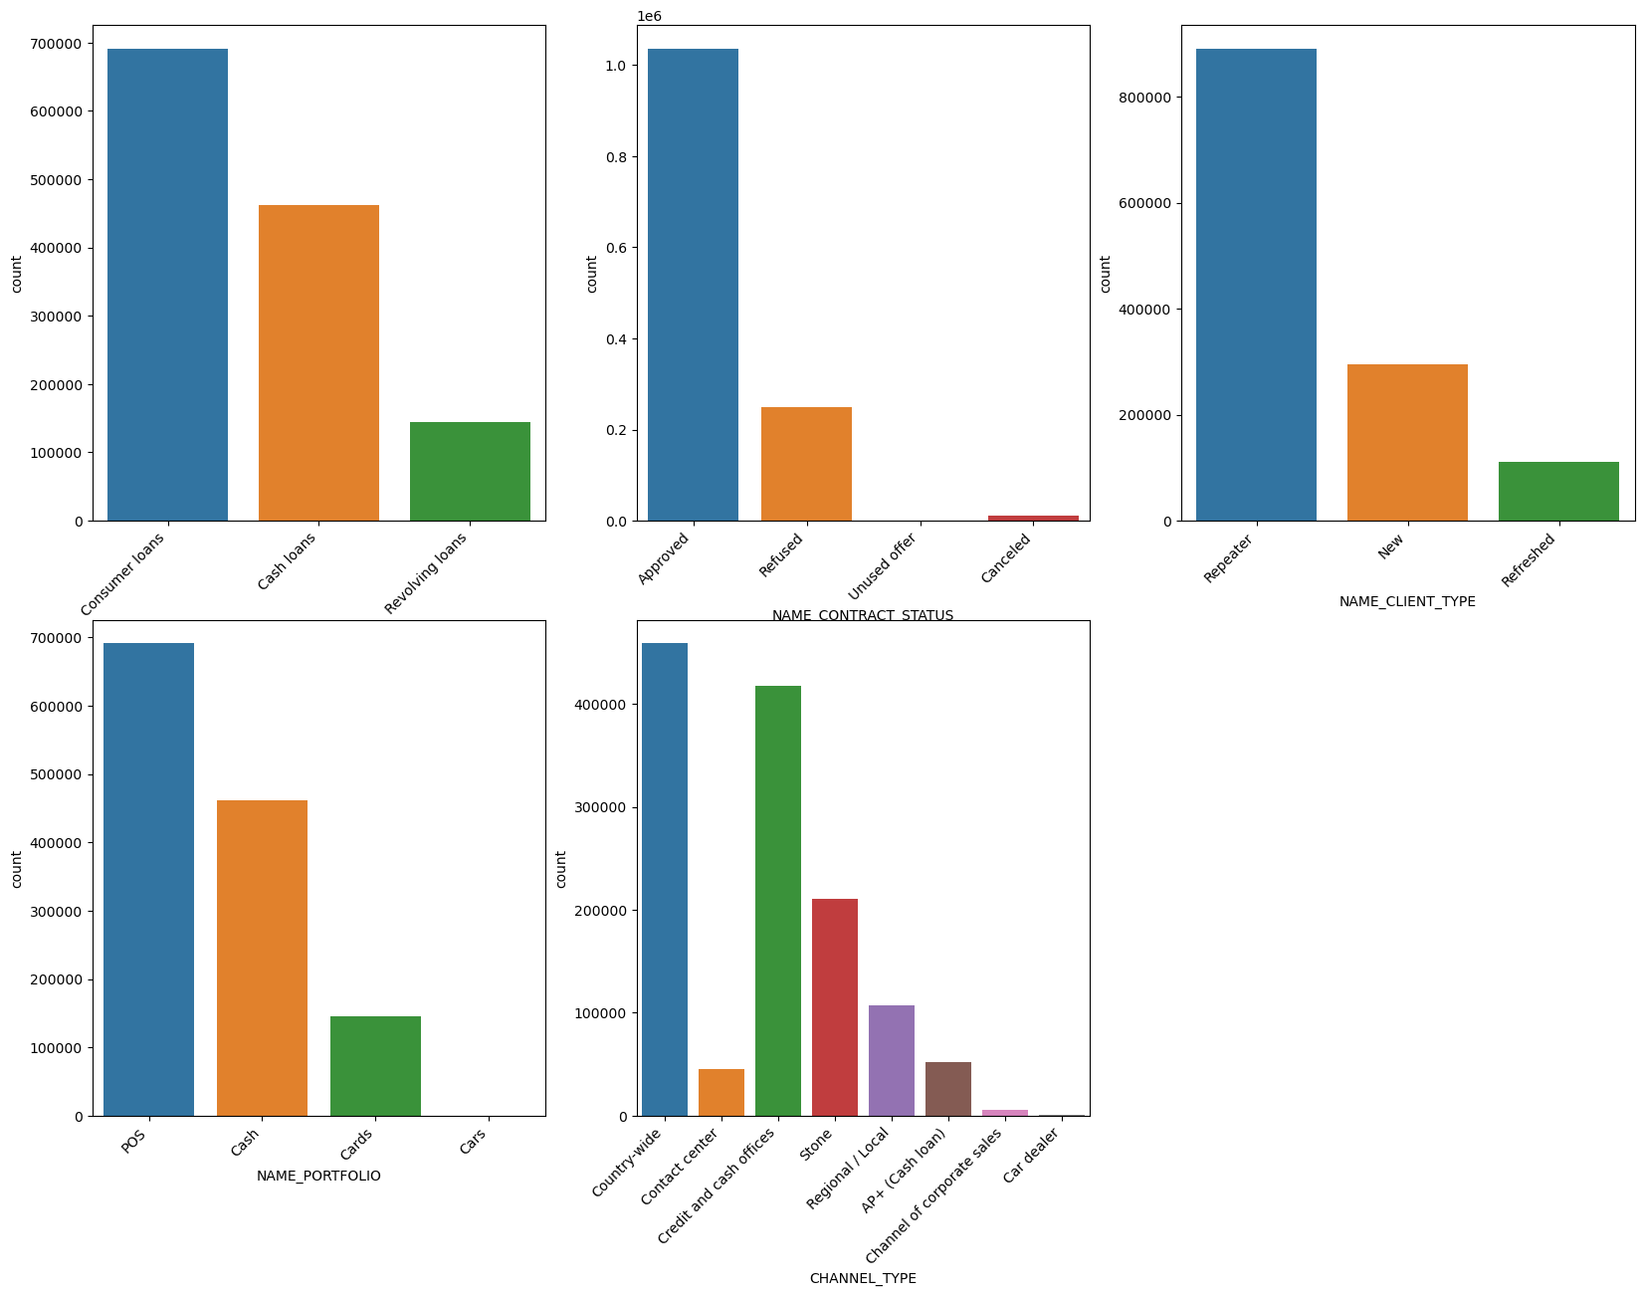
Data Imbalance

Slide 45
Results
Learned how a company should manage risk during giving loans to clients.
Understood visualizing techniques using python libraries (pandas, matplotlib, seaborn, etc.) and the senseful data from the graphs and charts.
Learned to present valuable insights and driving factors from the huge dataset.
Helped me to use EDA (Exploratory Data Analysis)and understand Risk Analysis in real business case scenes.
Understood about Outliers, Imputations, Handling missing values and errors, Data Imbalances and Variate analysis.

